Slide 1
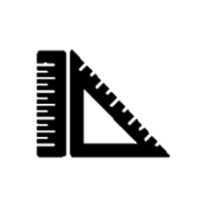
CamRuler
Group #10
Meet Patel
Kshitij Mehta
Prince Kowser

Slide 2
Background & Purpose
Measure objects using phone camera to increase efficiency/avoid doing by hand
Improves user interface of existing implementation by adding new features
Learning new technology
Built using Android Studio and Java
Original application can be found here: https://github.com/GoncaloJoaoCorreia/camera-ruler

Slide 3
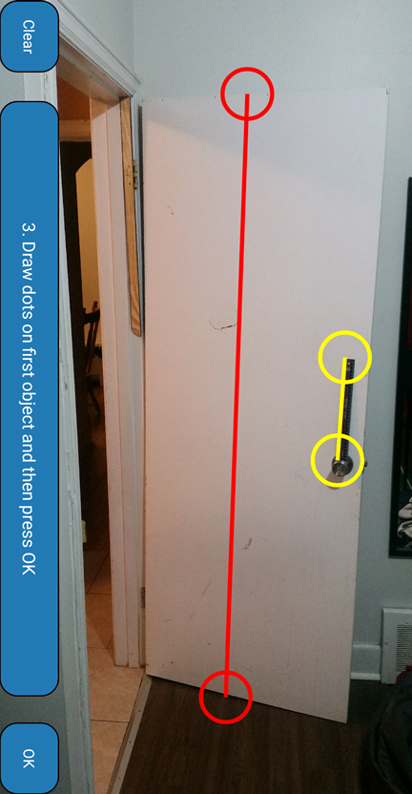
Example

Slide 4
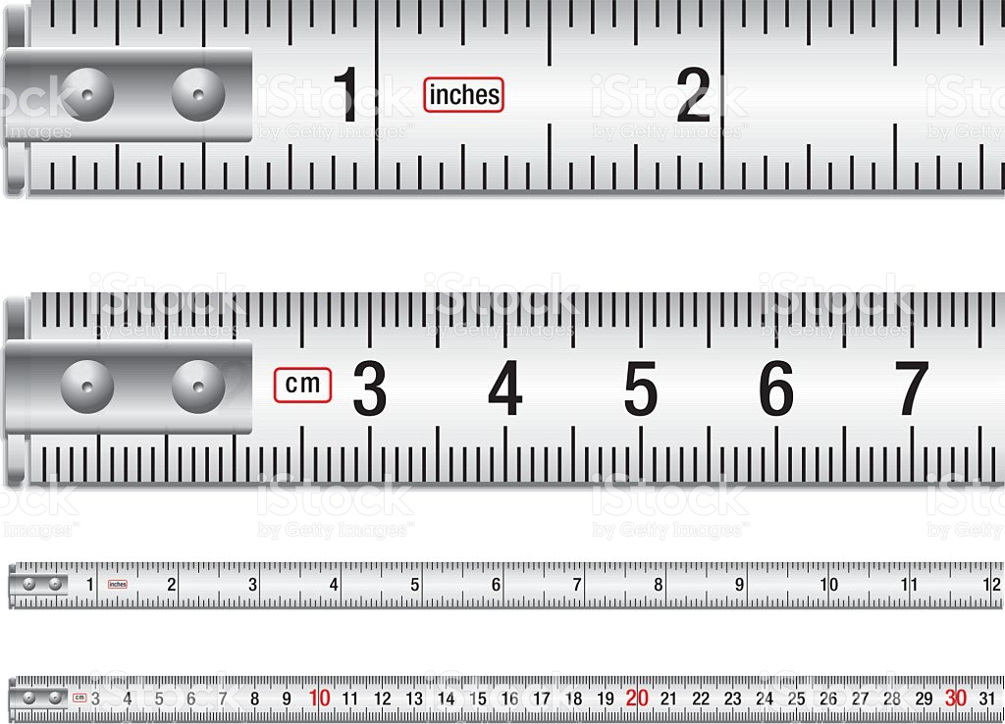

Scope
Can be used by anyone who can operate a phone, its camera, and needs measurements
Runs on all Android phones v4.0 and higher
Calculates and converts in various metrics

Slide 5


Demo

Slide 6
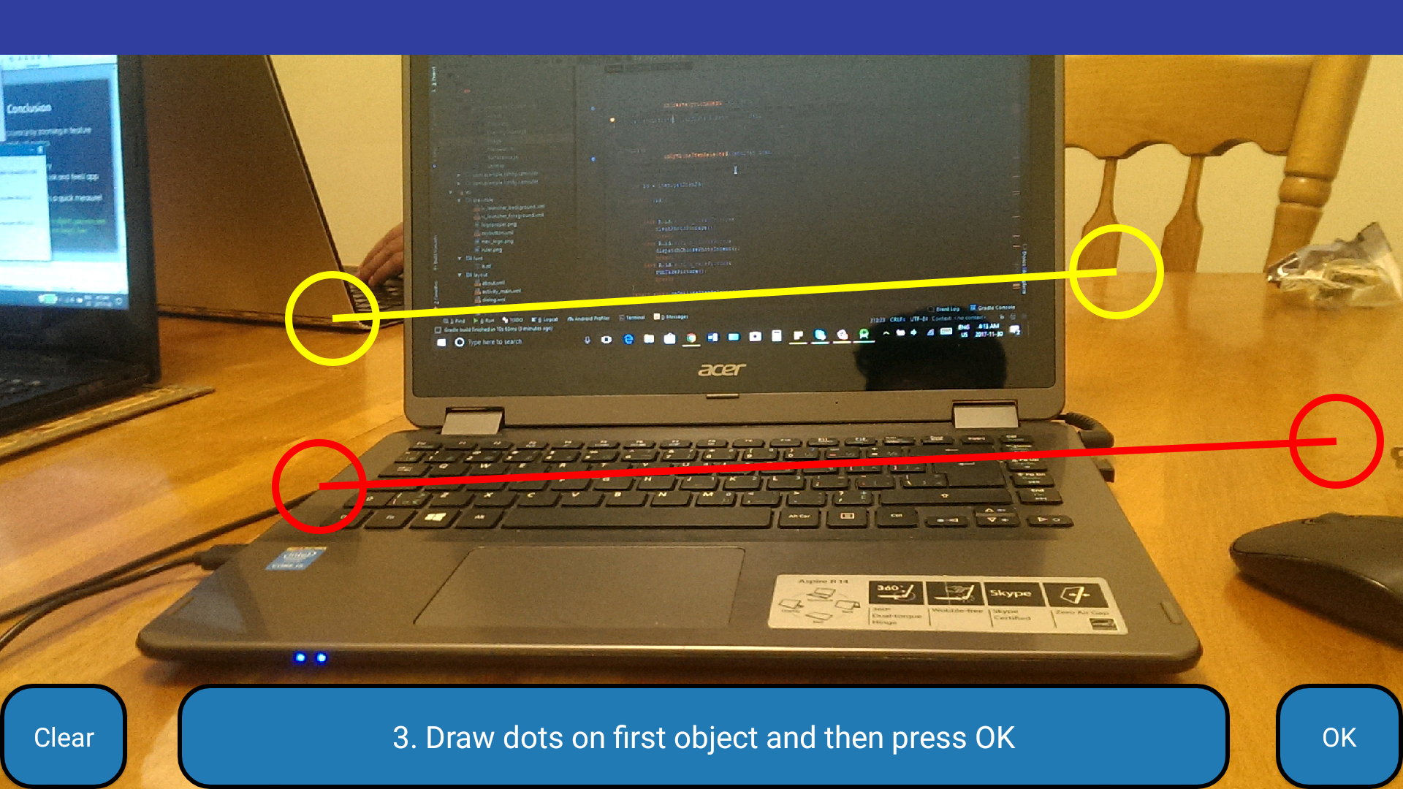
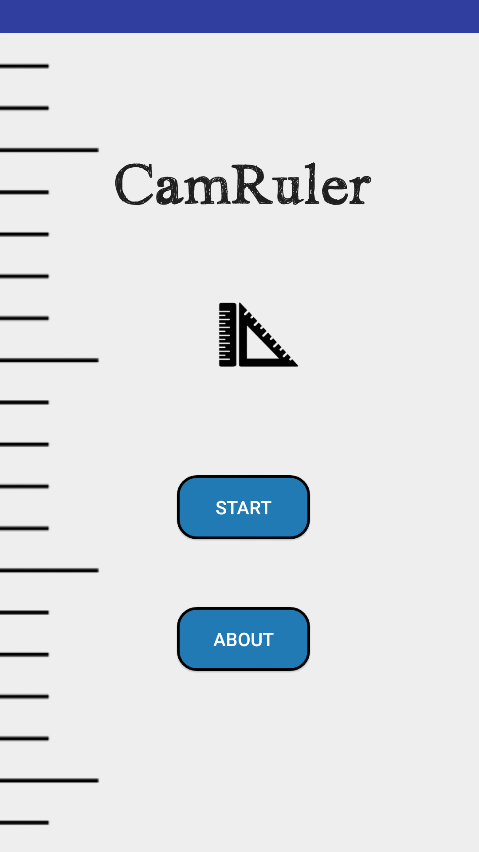
Additional Features/Fixes
Improved user interface
Improved picture quality
Resizing lines through drag and drop
Measure 2 objects with the same picture
Retake a picture
Error messages indicating how to fix error

Slide 7
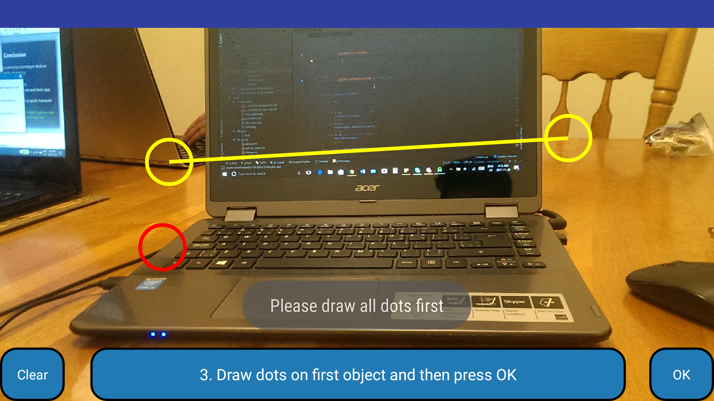
Qualities
User-friendly
interactive with correct error messages and instructions
able to retake pictures
Portability
Anywhere, anytime
works without internet
works on any Android phone v4.0 and higher

Slide 8
Qualities
Maintenance
minimal product maintenance
Robustness
user receives error message and opportunity to fix incorrect inputs
Performance
more accurate measurements with dragging lines feature
instantaneous calculations

Slide 9
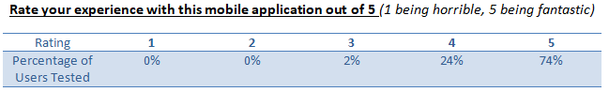
Testing
Manual, functional, dynamic testing done to check requirements
Unit Testing done by creating sample calculation stubs in Junit
User feedback survey:

Slide 10
Conclusion
Future Plans
Improve accuracy by zooming in feature
Measure curved objects
Select picture from photo gallery
Useful for anyone who wants a quick measure
TIP: If you do not have a reference object, you can use: a quarter(1 inch), credit card(8.5 cm long), line paper(8.5 inches wide)

Slide 11
Questions???

